Slide 1
COMBINATIONAL LOGIC digital logic design

Slide 2
Combinational Circuits
Output is function of input only
i.e. no feedback
When input changes, output may change (after a delay)
Combinational
Circuits
n inputs
m outputs
•
•
•
•
•
•
✗

Slide 3
Combinational Circuits
Analysis
Given a circuit, find out its function
Function may be expressed as:
Boolean function
Truth table
Design
Given a desired function, determine its circuit
Function may be expressed as:
Boolean function
Truth table
?
?
?

Slide 4
Analysis Procedure
Boolean Expression Approach
T₂=ABC
T₁=A+B+C
T₃=AB'C'+A'BC'+A'B'C
F’₂=(A’+B’)(A’+C’)(B’+C’)
F₂=AB+AC+BC
F₁=AB'C'+A'BC'+A'B'C+ABC
F₂=AB+AC+BC

Slide 5
Analysis Procedure
Truth Table Approach
A B C | F₁ | F₂
0 0 0
= 0
= 0
= 0
= 0
= 0
= 0
= 0
= 0
= 0
= 0
= 0
= 0
0 0
0
0
0
0
0
0
0
1
0

Slide 6
Analysis Procedure
Truth Table Approach
A B C | F₁ | F₂
0 0 0 | 0 | 0
0 0 1
= 0
= 0
= 1
= 0
= 0
= 1
= 0
= 0
= 0
= 1
= 0
= 1
0
1
0
0
0
1
1 0
1
1
0

Slide 7
Analysis Procedure
Truth Table Approach
A B C | F₁ | F₂
0 0 0 | 0 | 0
0 0 1 | 1 | 0
0 1 0
= 0
= 1
= 0
= 0
= 1
= 0
= 0
= 1
= 0
= 0
= 1
= 0
0
1
0
0
0
1
1 0
1
1
0

Slide 8
Analysis Procedure
Truth Table Approach
A B C | F₁ | F₂
0 0 0 | 0 | 0
0 0 1 | 1 | 0
0 1 0 | 1 | 0
0 1 1
= 0
= 1
= 1
= 0
= 1
= 1
= 0
= 1
= 0
= 1
= 1
= 1
0
1
0
0
1
0
0
0 1
0
1

Slide 9
Analysis Procedure
Truth Table Approach
A B C | F₁ | F₂
0 0 0 | 0 | 0
0 0 1 | 1 | 0
0 1 0 | 1 | 0
0 1 1 | 0 | 1
1 0 0
= 1
= 0
= 0
= 1
= 0
= 0
= 1
= 0
= 1
= 0
= 0
= 0
0
1
0
0
0
1
1
1
1 0
0

Slide 10
Analysis Procedure
Truth Table Approach
A B C | F₁ | F₂
0 0 0 | 0 | 0
0 0 1 | 1 | 0
0 1 0 | 1 | 0
0 1 1 | 0 | 1
1 0 0 | 1 | 0
1 0 1
= 1
= 0
= 1
= 1
= 0
= 1
= 1
= 0
= 1
= 1
= 0
= 1
0
1
0
1
0
0
0
0
0 1
1

Slide 11
Analysis Procedure
Truth Table Approach
A B C | F₁ | F₂
0 0 0 | 0 | 0
0 0 1 | 1 | 0
0 1 0 | 1 | 0
0 1 1 | 0 | 1
1 0 0 | 1 | 0
1 0 1 | 0 | 1
1 1 0
= 1
= 1
= 0
= 1
= 1
= 0
= 1
= 1
= 1
= 0
= 1
= 0
0
1
1
0
0
0
0
0
0 1
1

Slide 12
Analysis Procedure
Truth Table Approach
A B C | F₁ | F₂
0 0 0 | 0 | 0
0 0 1 | 1 | 0
0 1 0 | 1 | 0
0 1 1 | 0 | 1
1 0 0 | 1 | 0
1 0 1 | 0 | 1
1 1 0 | 0 | 1
1 1 1
= 1
= 1
= 1
= 1
= 1
= 1
= 1
= 1
= 1
= 1
= 1
= 1
1
1
1
1
1
1
0
0
1
1 1
 |  |  |  | B
 |  | 0 | 1 | 0 | 1
A |  | 1 | 0 | 1 | 0
 |  |  | C
 |  |  |  | B
 |  | 0 | 0 | 1 | 0
A |  | 0 | 1 | 1 | 1
 |  |  | C
F₁=AB'C'+A'BC'+A'B'C+ABC
F₂=AB+AC+BC

Slide 13
Design Procedure
Given a problem statement:
Determine the number of inputs and outputs
Derive the truth table
Simplify the Boolean expression for each output
Produce the required circuit
Example:
Design a circuit to convert a “BCD” code to “Excess 3” code
4-bits
0-9 values
?
4-bits
Value+3

Slide 14
Design Procedure
BCD-to-Excess 3 Converter
 |  |  |  | C
 |  |  | 1 | 1 | 1 | B
A |  | x | x | x | x
 |  | 1 | 1 | x | x
 |  |  | D
 |  |  |  | C
 |  |  | 1 | 1 | 1
 |  | 1 |  |  |  | B
A |  | x | x | x | x
 |  |  | 1 | x | x
 |  |  | D
A B C D | w x y z
0 0 0 0 | 0 0 1 1
0 0 0 1 | 0 1 0 0
0 0 1 0 | 0 1 0 1
0 0 1 1 | 0 1 1 0
0 1 0 0 | 0 1 1 1
0 1 0 1 | 1 0 0 0
0 1 1 0 | 1 0 0 1
0 1 1 1 | 1 0 1 0
1 0 0 0 | 1 0 1 1
1 0 0 1 | 1 1 0 0
1 0 1 0 | x x x x
1 0 1 1 | x x x x
1 1 0 0 | x x x x
1 1 0 1 | x x x x
1 1 1 0 | x x x x
1 1 1 1 | x x x x
w = A+BC+BD
x = B’C+B’D+BC’D’
 |  |  |  | C
 |  | 1 |  | 1
 |  | 1 |  | 1 |  | B
A |  | x | x | x | x
 |  | 1 |  | x | x
 |  |  | D
 |  |  |  | C
 |  | 1 |  |  | 1
 |  | 1 |  |  | 1 | B
A |  | x | x | x | x
 |  | 1 |  | x | x
 |  |  | D
y = C’D’+CD
z = D’

Slide 15
Design Procedure
BCD-to-Excess 3 Converter
A B C D | w x y z
0 0 0 0 | 0 0 1 1
0 0 0 1 | 0 1 0 0
0 0 1 0 | 0 1 0 1
0 0 1 1 | 0 1 1 0
0 1 0 0 | 0 1 1 1
0 1 0 1 | 1 0 0 0
0 1 1 0 | 1 0 0 1
0 1 1 1 | 1 0 1 0
1 0 0 0 | 1 0 1 1
1 0 0 1 | 1 1 0 0
1 0 1 0 | x x x x
1 0 1 1 | x x x x
1 1 0 0 | x x x x
1 1 0 1 | x x x x
1 1 1 0 | x x x x
1 1 1 1 | x x x x
w = A + B(C+D)
y = (C+D)’ + CD
x = B’(C+D) + B(C+D)’
z = D’

Slide 16
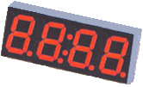
Seven-Segment Decoder
a
w x y z | a b c d e f g
0 0 0 0 | 1 1 1 1 1 1 0
0 0 0 1 | 0 1 1 0 0 0 0
0 0 1 0 | 1 1 0 1 1 0 1
0 0 1 1 | 1 1 1 1 0 0 1
0 1 0 0 | 0 1 1 0 0 1 1
0 1 0 1 | 1 0 1 1 0 1 1
0 1 1 0 | 1 0 1 1 1 1 1
0 1 1 1 | 1 1 1 0 0 0 0
1 0 0 0 | 1 1 1 1 1 1 1
1 0 0 1 | 1 1 1 1 0 1 1
1 0 1 0 | x x x x x x x
1 0 1 1 | x x x x x x x
1 1 0 0 | x x x x x x x
1 1 0 1 | x x x x x x x
1 1 1 0 | x x x x x x x
1 1 1 1 | x x x x x x x
w
x
y
z
a
b
c
d
e
f
g
f
b
?
g
e
c
BCD code
d
 |  |  |  | y
 |  | 1 |  | 1 | 1
 |  |  | 1 | 1 | 1 | x
w |  | x | x | x | x
 |  | 1 | 1 | x | x
 |  |  | z
a = w + y + xz + x’z’
b = . . .
c = . . .
d = . . .

Slide 17
Binary Adder
Half Adder
Adds 1-bit plus 1-bit
Produces Sum and Carry
x
y
S
C
HA
x
+ y
───
C S
x y | C S
0 0 | 0 0
0 1 | 0 1
1 0 | 0 1
1 1 | 1 0
x
y
S
C

Slide 18
Binary Adder
Full Adder
Adds 1-bit plus 1-bit plus 1-bit
Produces Sum and Carry
x
y
z
S
C
FA
x
+ y
+ z
───
C S
x y z | C S
0 0 0 | 0 0
0 0 1 | 0 1
0 1 0 | 0 1
0 1 1 | 1 0
1 0 0 | 0 1
1 0 1 | 1 0
1 1 0 | 1 0
1 1 1 | 1 1
 |  |  |  | y
 |  | 0 | 1 | 0 | 1
x |  | 1 | 0 | 1 | 0
 |  |  | z
S = xy'z'+x'yz'+x'y'z+xyz = x ⊕ y ⊕ z
 |  |  |  | y
 |  | 0 | 0 | 1 | 0
x |  | 0 | 1 | 1 | 1
 |  |  | z
C = xy + xz + yz

Slide 19
Binary Adder
Full Adder
S = xy'z'+x'yz'+x'y'z+xyz = x ⊕ y ⊕ z
C = xy + xz + yz
x
y
z
S
C
S
C
x
y
z

Slide 20
Binary Adder
Full Adder
HA
HA
x
y
z
S
C
x
y
z
S
C

Slide 21
Binary Adder
x₃x₂x₁x₀ y₃y₂y₁y₀
c₃ c₂ c₁ .
+ x₃ x₂ x₁ x₀
+ y₃ y₂ y₁ y₀
────────
Cy S₃ S₂ S₁ S₀
Binary Adder
Carry Propagate Addition
C_{y}
C₀
S₃S₂S₁S₀
x₃ x₂ x₁ x₀
y₃ y₂ y₁ y₀
0
FA
FA
FA
FA
C₄ C₃ C₂ C₁
S₃ S₂ S₁ S₀

Slide 22
Binary Adder
Carry Propagate Adder
x₇ x₆ x₅ x₄
x₃ x₂ x₁ x₀
y₇ y₆ y₅ y₄
y₃ y₂ y₁ y₀
CPA
CPA
A₃ A₂ A₁ A₀
B₃ B₂ B₁ B₀
A₃ A₂ A₁ A₀
B₃ B₂ B₁ B₀
C_{y}
C₀
C_{y}
C₀
0
S₃ S₂ S₁ S₀
S₃ S₂ S₁ S₀
S₇ S₆ S₅ S₄
S₃ S₂ S₁ S₀

Slide 23
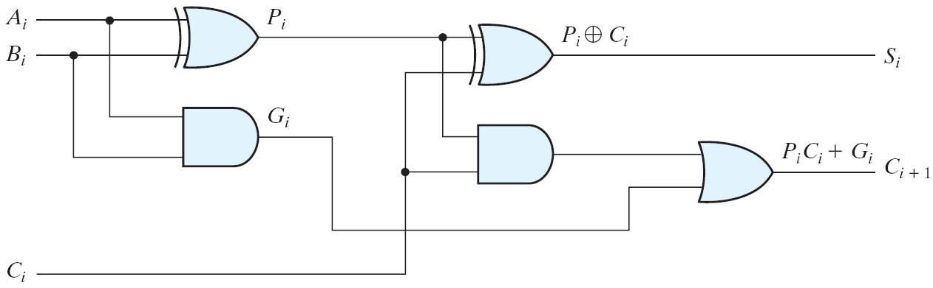
Figure 4.10 Full Adder with P and G Shown
Carry propagation
When the correct outputs are available
The critical path counts (the worst case)
(A₁, B₁, C₁) → C₂ → C₃ → C₄ → (C₅, S₄)
When 4-bits full-adder → 8 gate levels (n-bits: 2n gate levels)

Slide 24
Parallel Adders
Reduce the carry propagation delay
Employ faster gates
Look-ahead carry (more complex mechanism, yet faster)
Carry propagate: P_{i} = A_{i}⊕B_{i}
Carry generate: G_{i} = A_{i}B_{i}
Sum: S_{i} = P_{i}⊕C_{i}
Carry: C_{i+1} = G_{i}+P_{i}C_{i}
C₀ = Input carry
C₁ = G₀+P₀C₀
C₂ = G₁+P₁C₁ = G₁+P₁(G₀+P₀C₀) = G₁+P₁G₀+P₁P₀C₀
C₃ = G₂+P₂C₂ = G₂+P₂G₁+P₂P₁G₀+ P₂P₁P₀C₀

Slide 25
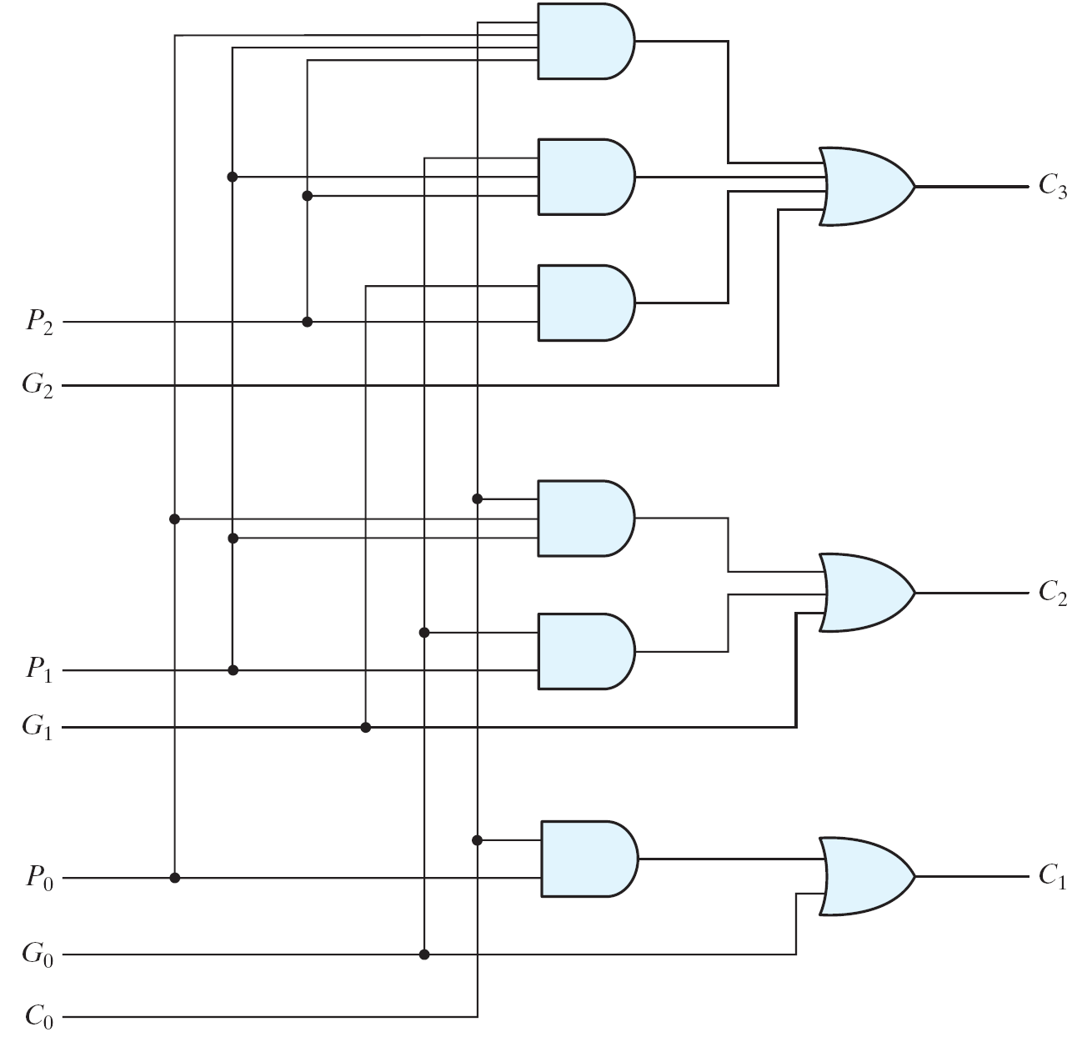
Carry Look-ahead Adder (1/2)
Fig. 4.11 Logic Diagram of Carry Look-ahead Generator
Logic diagram

Slide 26
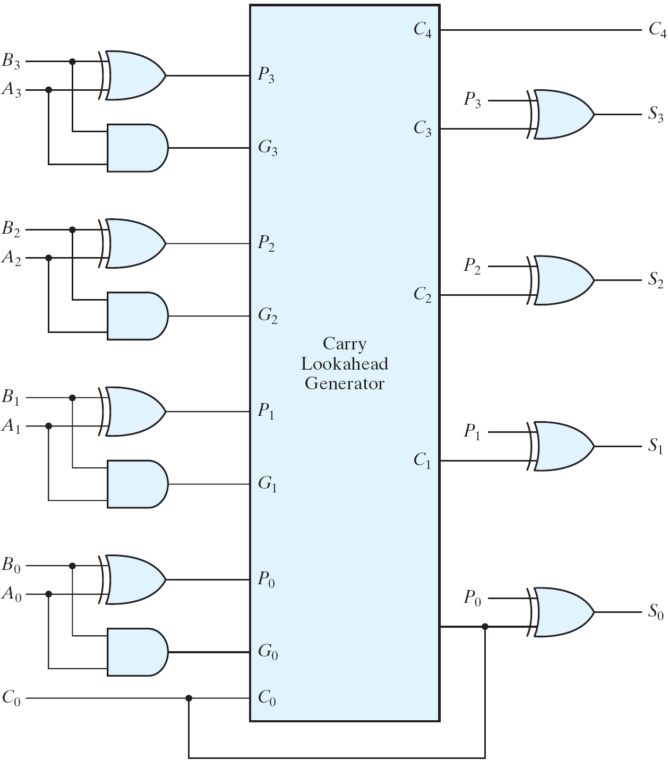
Carry Look-ahead Adder (2/2)
4-bit carry-look ahead adder
Propagation delay of C₃, C₂ and C₁ are equal.
Fig. 4.12 4-Bit Adder with Carry Look-ahead

Slide 27
BCD Adder
4-bits plus 4-bits
Operands and Result: 0 to 9
+ x₃ x₂ x₁ x₀
+ y₃ y₂ y₁ y₀
────────
Cy S₃ S₂ S₁ S₀
X +Y | x₃ x₂ x₁ x₀ | y₃ y₂ y₁ y₀ | Sum | Cy | S₃ S₂ S₁ S₀
0 + 0 | 0 0 0 0 | 0 0 0 0 | = 0 | 0 | 0 0 0 0
0 + 1 | 0 0 0 0 | 0 0 0 1 | = 1 | 0 | 0 0 0 1
0 + 2 | 0 0 0 0 | 0 0 1 0 | = 2 | 0 | 0 0 1 0
0 + 9 | 0 0 0 0 | 1 0 0 1 | = 9 | 0 | 1 0 0 1
1 + 0 | 0 0 0 1 | 0 0 0 0 | = 1 | 0 | 0 0 0 1
1 + 1 | 0 0 0 1 | 0 0 0 1 | = 2 | 0 | 0 0 1 0
1 + 8 | 0 0 0 1 | 1 0 0 0 | = 9 | 0 | 1 0 0 1
1 + 9 | 0 0 0 1 | 1 0 0 1 | = A | 0 | 1 0 1 0
Invalid Code
2 + 0 | 0 0 1 0 | 0 0 0 0 | = 2 | 0 | 0 0 1 0
9 + 9 | 1 0 0 1 | 1 0 0 1 | = 12 | 1 | 0 0 1 0
Wrong BCD Value
0001 1000

Slide 28
BCD Adder
X +Y | x₃ x₂ x₁ x₀ | y₃ y₂ y₁ y₀ | Sum | Cy | S₃ S₂ S₁ S₀ | Required BCD Output | Value
9 + 0 | 1 0 0 1 | 0 0 0 0 | = 9 | 0 | 1 0 0 1 | 0 0 0 0 1 0 0 1 | = 9
9 + 1 | 1 0 0 1 | 0 0 0 1 | = 10 | 0 | 1 0 1 0 | 0 0 0 1 0 0 0 0 | = 16
9 + 2 | 1 0 0 1 | 0 0 1 0 | = 11 | 0 | 1 0 1 1 | 0 0 0 1 0 0 0 1 | = 17
9 + 3 | 1 0 0 1 | 0 0 1 1 | = 12 | 0 | 1 1 0 0 | 0 0 0 1 0 0 1 0 | = 18
9 + 4 | 1 0 0 1 | 0 1 0 0 | = 13 | 0 | 1 1 0 1 | 0 0 0 1 0 0 1 1 | = 19
9 + 5 | 1 0 0 1 | 0 1 0 1 | = 14 | 0 | 1 1 1 0 | 0 0 0 1 0 1 0 0 | = 20
9 + 6 | 1 0 0 1 | 0 1 1 0 | = 15 | 0 | 1 1 1 1 | 0 0 0 1 0 1 0 1 | = 21
9 + 7 | 1 0 0 1 | 0 1 1 1 | = 16 | 1 | 0 0 0 0 | 0 0 0 1 0 1 1 0 | = 22
9 + 8 | 1 0 0 1 | 1 0 0 0 | = 17 | 1 | 0 0 0 1 | 0 0 0 1 0 1 1 1 | = 23
9 + 9 | 1 0 0 1 | 1 0 0 1 | = 18 | 1 | 0 0 1 0 | 0 0 0 1 1 0 0 0 | = 24
✗
✗
✗
✗
✗
✗
✗
✗
✗
+ 6

Slide 29
BCD Adder
Correct Binary Adder’s Output (+6)
If the result is between ‘A’ and ‘F’
If Cy = 1
S₃ S₂ S₁ S₀ | Err
0 0 0 0 | 0
1 0 0 0 | 0
1 0 0 1 | 0
1 0 1 0 | 1
1 0 1 1 | 1
1 1 0 0 | 1
1 1 0 1 | 1
1 1 1 0 | 1
1 1 1 1 | 1
 |  |  |  | S₁
 |  |  |  |  |  | S₂
S₃ |  | 1 | 1 | 1 | 1
 |  |  |  | 1 | 1
 |  |  | S₀
Err = S₃ S₂ + S₃ S₁

Slide 30
BCD Adder
Err

Slide 31
Binary Subtractor
Use 2’s complement with binary adder
x – y = x + (-y) = x + y’ + 1

Slide 32
Binary Adder/Subtractor
M: Control Signal (Mode)
M=0 ➔ F = x + y
M=1 ➔ F = x – y

Slide 33
Overflow
Unsigned Binary Numbers
2’s Complement Numbers
x₃ x₂ x₁ x₀
y₃ y₂ y₁ y₀
0
FA
FA
FA
FA
Carry
C₄ C₃ C₂ C₁
S₃ S₂ S₁ S₀
x₃ x₂ x₁ x₀
y₃ y₂ y₁ y₀
0
FA
FA
FA
FA
Overflow
C₄ C₃ C₂ C₁
S₃ S₂ S₁ S₀

Slide 34
Magnitude Comparator
Compare 4-bit number to 4-bit number
3 Outputs: < , = , >
Expandable to more number of bits
A₃A₂A₁A₀ B₃B₂B₁B₀
Magnitude Comparator
A<B A=B A>B

Slide 35
Magnitude Comparator

Slide 36
Magnitude Comparator
x₇ x₆ x₅ x₄
x₃ x₂ x₁ x₀
y₇ y₆ y₅ y₄
y₃ y₂ y₁ y₀
Magnitude Comparator
A₃ A₂ A₁ A₀
B₃ B₂ B₁ B₀
Magnitude Comparator
A₃ A₂ A₁ A₀
B₃ B₂ B₁ B₀
0
1
0
I_{(A>B)}
I_{(A=B)}
I_{(A<B)}
I_{(A>B)}
I_{(A=B)}
I_{(A<B)}
A<B A=B A>B
A<B A=B A>B
A<B A=B A>B

Slide 37
Decoders
Extract “Information” from the code
Binary Decoder
Example: 2-bit Binary Number
Only one lamp will turn on
0
1
2
3
Binary Decoder
1
0
0
0
x₁
x₀
0
0

Slide 38
Decoders
2-to-4 Line Decoder
Binary Decoder
y₃
y₂
y₁
y₀
I₁
I₀
I₁ I₀ | Y₃ Y₂ Y₁ Y₀
0 0 | 0 0 0 1
0 1 | 0 0 1 0
1 0 | 0 1 0 0
1 1 | 1 0 0 0

Slide 39
Decoders
3-to-8 Line Decoder
Binary Decoder
Y₇
Y₆
Y₅
Y₄ Y₃
Y₂
Y₁
Y₀
I₂
I₁
I₀

Slide 40
Decoders
“Enable” Control
Binary Decoder
Y₃
Y₂
Y₁
Y₀
I₁
I₀
E
E | I₁ I₀ | Y₃ Y₂ Y₁ Y₀
0 | x x | 0 0 0 0
1 | 0 0 | 0 0 0 1
1 | 0 1 | 0 0 1 0
1 | 1 0 | 0 1 0 0
1 | 1 1 | 1 0 0 0

Slide 41
Decoders
Expansion
I₂ I₁ I₀
I₂ I₁ I₀ | Y₇ Y₆ Y₅ Y₄ Y₃ Y₂ Y₁ Y₀
0 0 0 | 0 0 0 0 0 0 0 1
0 0 1 | 0 0 0 0 0 0 1 0
0 1 0 | 0 0 0 0 0 1 0 0
0 1 1 | 0 0 0 0 1 0 0 0
1 0 0 | 0 0 0 1 0 0 0 0
1 0 1 | 0 0 1 0 0 0 0 0
1 1 0 | 0 1 0 0 0 0 0 0
1 1 1 | 1 0 0 0 0 0 0 0
Binary Decoder
Y₇
Y₆
Y₅
Y₄
Y₃
Y₂
Y₁
Y₀
Y₃
Y₂
Y₁
Y₀
I₀
I₁
E
Binary Decoder
Y₃
Y₂
Y₁
Y₀
I₀
I₁
E

Slide 42
Decoders
Active-High / Active-Low
I₁ I₀ | Y₃ Y₂ Y₁ Y₀
0 0 | 0 0 0 1
0 1 | 0 0 1 0
1 0 | 0 1 0 0
1 1 | 1 0 0 0
I₁ I₀ | Y₃ Y₂ Y₁ Y₀
0 0 | 1 1 1 0
0 1 | 1 1 0 1
1 0 | 1 0 1 1
1 1 | 0 1 1 1
Binary Decoder
Binary Decoder
Y₃
Y₂
Y₁
Y₀
Y₃
Y₂
Y₁
Y₀
I₁
I₀
I₁
I₀

Slide 43
Implementation Using Decoders
Each output is a minterm
All minterms are produced
Sum the required minterms
Example: Full Adder
S(x, y, z) = ∑(1, 2, 4, 7)
C(x, y, z) = ∑(3, 5, 6, 7)
Binary Decoder
Y₇
Y₆
Y₅
Y₄ Y₃
Y₂
Y₁
Y₀
x
y
z
I₂
I₁
I₀
S C

Slide 44
Implementation Using Decoders
Binary Decoder
Binary Decoder
Y₇
Y₆
Y₅
Y₄ Y₃
Y₂
Y₁
Y₀
Y₇
Y₆
Y₅
Y₄
Y₃
Y₂
Y₁
Y₀
x
y
z
I₂
I₁
I₀
x
y
z
I₂
I₁
I₀
S C
S C

Slide 45
Encoders
Put “Information” into code
Binary Encoder
Example: 4-to-2 Binary Encoder
Only one switch should be activated at a time
1
x₁
x₂
x₃
Binary Encoder
x₃ x₂ x₁ | y₁ y₀
0 0 0 | 0 0
0 0 1 | 0 1
0 1 0 | 1 0
1 0 0 | 1 1
y₁
y₀
2
3

Slide 46
Encoders
Octal-to-Binary Encoder (8-to-3)
Binary Encoder
I₇
I₆
I₅
I₄ I₃
I₂
I₁
I₀
I₇ I₆ I₅ I₄ I₃ I₂ I₁ I₀ | Y₂ Y₁ Y₀
0 0 0 0 0 0 0 1 | 0 0 0
0 0 0 0 0 0 1 0 | 0 0 1
0 0 0 0 0 1 0 0 | 0 1 0
0 0 0 0 1 0 0 0 | 0 1 1
0 0 0 1 0 0 0 0 | 1 0 0
0 0 1 0 0 0 0 0 | 1 0 1
0 1 0 0 0 0 0 0 | 1 1 0
1 0 0 0 0 0 0 0 | 1 1 1
Y₂
Y₁
Y₀

Slide 47
Priority Encoders
4-Input Priority Encoder
Priority Encoder
I₃
I₂
I₁
I₀
V
Y₁
Y₀
I₃ I₂ I₁ I₀ | Y₁ Y₀ | V
0 0 0 0 | 0 0 | 0
0 0 0 1 | 0 0 | 1
0 0 1 x | 0 1 | 1
0 1 x x | 1 0 | 1
1 x x x | 1 1 | 1
Y₁ |  |  |  | I₁
 |  | 1 | 1 | 1 | 1 | I₂
I₃ |  | 1 | 1 | 1 | 1
 |  | 1 | 1 | 1 | 1
 |  |  | I₀

Slide 48
Encoder / Decoder Pairs
Binary Encoder
Binary Decoder
Y₇
Y₆
Y₅
Y₄ Y₃
Y₂
Y₁
Y₀
7
7
I₇
I₆
I₅
I₄ I₃
I₂
I₁
I₀
6
6
5
5
Y₂
Y₁
Y₀
I₂
I₁
I₀
4
4
3
3
2
2
1
1
0
0

Slide 49
Multiplexers
S₁ S₀ | Y
0 0 | I₀
0 1 | I₁
1 0 | I₂
1 1 | I₃
MUX
I₀
I₁
I₂
I₃
Y
S₁ S₀

Slide 50
Multiplexers
2-to-1 MUX
4-to-1 MUX
MUX
I₀
I₁
Y
S
MUX
I₀
I₁
I₂
I₃
Y
S₁ S₀

Slide 51
Multiplexers
Quad 2-to-1 MUX
x₃
x₂
x₁
x₀
MUX
I₀
I₁
y₃
y₂
y₁
y₀
Y
S
MUX
I₀
I₁
Y
S
MUX
A₃
A₂
A₁
A₀
MUX
I₀
I₁
Y₃
Y₂
Y₁
Y₀
Y
S
B₃
B₂
B₁
B₀
MUX
I₀
I₁
Y
S
S E
S

Slide 52
Multiplexers
Quad 2-to-1 MUX
MUX
A₃
A₂
A₁
A₀
Y₃
Y₂
Y₁
Y₀
B₃
B₂
B₁
B₀
S E
Extra Buffers

Slide 53
Implementation Using Multiplexers
Example F(x, y) = ∑(0, 1, 3)
x y | F
0 0 | 1
0 1 | 1
1 0 | 0
1 1 | 1
MUX
1
1
0
1
I₀
I₁
I₂
I₃
Y
F
S₁ S₀
x y

Slide 54
Implementation Using Multiplexers
Example F(x, y, z) = ∑(1, 2, 6, 7)
MUX
0
1
1
0
0
0
1
1
I₀
I₁
I₂
I₃ I₄
I₅
I₆
I₇
x y z | F
0 0 0 | 0
0 0 1 | 1
0 1 0 | 1
0 1 1 | 0
1 0 0 | 0
1 0 1 | 0
1 1 0 | 1
1 1 1 | 1
Y
F
S₂ S₁ S₀
x y z

Slide 55
Implementation Using Multiplexers
Example F(x, y, z) = ∑(1, 2, 6, 7)
x y z | F
0 0 0 | 0
0 0 1 | 1
0 1 0 | 1
0 1 1 | 0
1 0 0 | 0
1 0 1 | 0
1 1 0 | 1
1 1 1 | 1
z
MUX
I₀
I₁
I₂
I₃
F = z
F
z
0
Y
F = z
1
S₁ S₀
F = 0
x y
F = 1

Slide 56
Implementation Using Multiplexers
Example F(A, B, C, D) = ∑(1, 3, 4, 11, 12, 13, 14, 15)
A B C D | F
0 0 0 0 | 0
0 0 0 1 | 1
0 0 1 0 | 0
0 0 1 1 | 1
0 1 0 0 | 1
0 1 0 1 | 0
0 1 1 0 | 0
0 1 1 1 | 0
1 0 0 0 | 0
1 0 0 1 | 0
1 0 1 0 | 0
1 0 1 1 | 1
1 1 0 0 | 1
1 1 0 1 | 1
1 1 1 0 | 1
1 1 1 1 | 1
MUX
D
I₀
I₁
I₂
I₃ I₄
I₅
I₆
I₇
F = D
D
F = D
D
F = D
0
Y
F
0
F = 0
D
F = 0
1
F = D
1
S₂ S₁ S₀
F = 1
F = 1
A B C

Slide 57
Multiplexer Expansion
8-to-1 MUX using Dual 4-to-1 MUX
MUX
I₀
I₁
I₂
I₃
I₄
I₅
I₆
I₇
I₀
I₁
I₂
I₃
Y
S₁ S₀
MUX
I₀
I₁
Y
Y
MUX
S
I₀
I₁
I₂
I₃
Y
S₁ S₀
1
0 0
S₂ S₁ S₀

Slide 58
DeMultiplexers
DeMUX
Y₃
Y₂
Y₁
Y₀
I
S₁ S₀
S₁ S₀ | Y₃ | Y₂ | Y₁ | Y₀
0 0 | 0 | 0 | 0 | I
0 1 | 0 | 0 | I | 0
1 0 | 0 | I | 0 | 0
1 1 | I | 0 | 0 | 0

Slide 59
Multiplexer / DeMultiplexer Pairs
MUX
DeMUX
Y₇
Y₆
Y₅
Y₄ Y₃
Y₂
Y₁
Y₀
7
7
I₇
I₆
I₅
I₄ I₃
I₂
I₁
I₀
6
6
5
5
4
4
Y
I
3
3
2
2
1
1
0
0
S₂ S₁ S₀
S₂ S₁ S₀
Synchronize
x₂ x₁ x₀
y₂ y₁ y₀

Slide 60
DeMultiplexers / Decoders
DeMUX
Binary Decoder
Y₃
Y₂
Y₁
Y₀
Y₃
Y₂
Y₁
Y₀
I₁
I₀
E
I
S₁ S₀
E | I₁ I₀ | Y₃ Y₂ Y₁ Y₀
0 | x x | 0 0 0 0
1 | 0 0 | 0 0 0 1
1 | 0 1 | 0 0 1 0
1 | 1 0 | 0 1 0 0
1 | 1 1 | 1 0 0 0
S₁ S₀ | Y₃ | Y₂ | Y₁ | Y₀
0 0 | 0 | 0 | 0 | I
0 1 | 0 | 0 | I | 0
1 0 | 0 | I | 0 | 0
1 1 | I | 0 | 0 | 0

Slide 61
Three-State Gates
Tri-State Buffer
Tri-State Inverter
C A | Y
0 x | Hi-Z
1 0 | 0
1 1 | 1
A
Y
C
A
Y
C

Slide 62
Three-State Gates
C D | Y
0 0 | Hi-Z
0 1 | B
1 0 | A
1 1 | ?
A
Y
C
B
Not Allowed
D
A
C
A if C = 1
B if C = 0
Y=
B

Slide 63
Three-State Gates
I₃
I₂
Y
I₁
I₀
Binary Decoder
Y₃
Y₂
Y₁
Y₀
S₁
I₁
I₀
E
S₀
E

